Slide 1


DEPARTment of computer science and cyber security

Slide 2

CYBER THREAT DETECTION USING
ARTIFICIAL INTELLIGENCE

Slide 3
TEAM
GUIDE : Mrs. LAKSHMESWARI CHENNGIRI
MEMBERS:
VEMPATI HEMALATHA (Y21CSC053)
BODEMPUDI SRAVANI (Y21CSC008)
PATAN BAJI ALI KHAN (Y21CSC033)
KOLLA SRIDHAR (Y21CSC022)

Slide 4

ABSTRACT
This study presents an AI-driven approach for advanced malware detection using hybrid feature analysis, combining binary, hexadecimal data, and DLL call behaviour. The Genetic Programming Symbolic Classifier (GPSC) extracts symbolic expressions for malware classification, addressing data imbalance with oversampling and Random Hyperparameter Value Search (RHVS). Performance evaluation using five-fold cross-validation (5F’CV) shows high accuracy (0.9944).
Keywords: Malware detection, AI-SIEM, GPSC, CNN, LSTM, binary analysis, DLL calls, oversampling, deep learning, symbolic classifier.

Slide 5

OBJECTIVE
Enhanced Accuracy & Adaptability: Utilize ML and DL models (CNN, LSTM, GPSC) to detect evolving and polymorphic malware.
Real-time Threat Detection: Identify and mitigate cyber threats instantly using AI-driven techniques.
Automation & Efficiency: Reduce manual intervention by implementing AI-powered automated cybersecurity solutions.

Slide 6
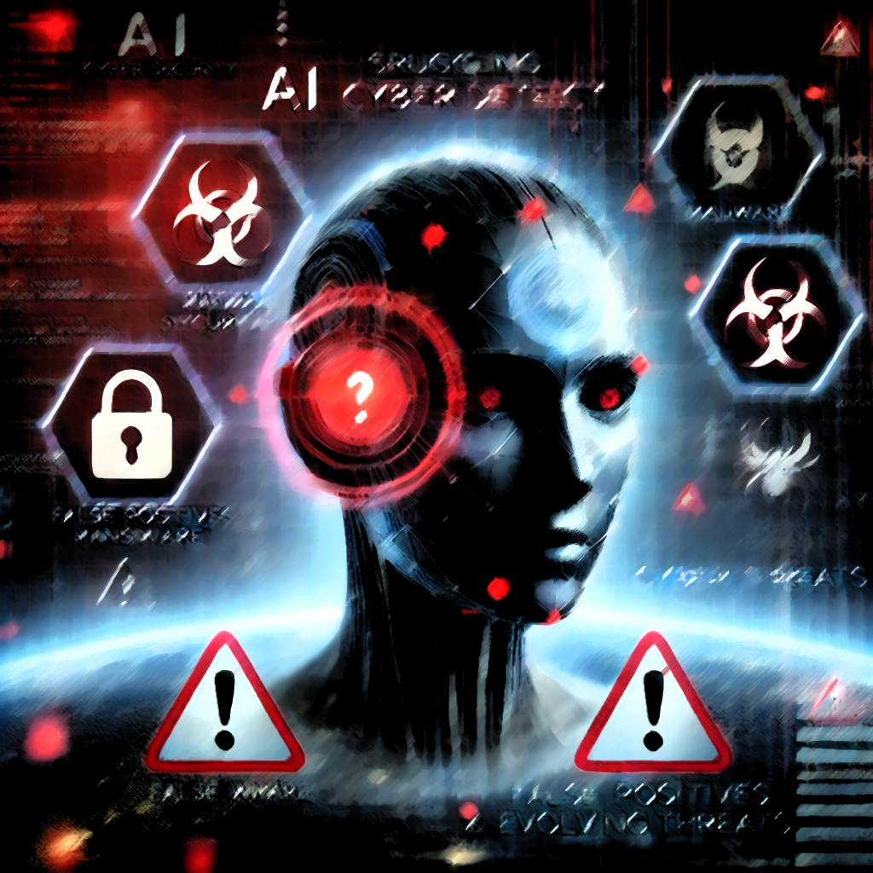
PROBLEM IDENTIFICATION
Evolving Cyber Threats : New attack techniques keep emerging.
High False Positives & False Negatives : Traditional methods misclassify threats.
Data Imbalance & Quality Issues : Lack of high-quality training data.
Real-time Processing Challenges : Need for fast and scalable solutions.
Adversarial Attacks on AI : AI models can be tricked by cybercriminals.

Slide 7
IMPLEMENTATION
Algorithms:
Programming languages & FRAMEWORKS:
Support Vector Machine
k - Nearest Neighbour
Naive Bayes
Decision Trees
Random Forest
Long Short -Term Memory
Convolutional Neutral Network
Python
Scikit-Learn
Pandas
Matplotlib
Keras
TensorFlow

Slide 8
Existing system
Rule-Based Detection – Uses predefined rules to detect threats but struggles with new and evolving attacks.
Machine Learning Models – Uses algorithms like SVM and Random Forest but requires large datasets and may produce false positives.
Deep Learning Approaches – Uses CNN and LSTM for better accuracy but needs high computational power and training data.

Slide 9

PROPOSED SYSTEM
AI-Driven Detection – Uses machine learning and deep learning to identify cyber threats more accurately.
Automated Threat Analysis – Detects and classifies threats in real-time, reducing manual effort.
Adaptive Security – Continuously learns from new threats to improve detection and prevention

Slide 10
CONCLUSION
Enhanced Threat Detection – AI improves accuracy in identifying cyber threats by analyzing patterns and anomalies.
Real-Time Monitoring – AI enables continuous and proactive threat detection to prevent attacks before they cause damage.
Reduced False Alarms – Advanced AI models minimize false positives, ensuring better security responses.
Automation & Efficiency – AI automates cybersecurity processes, reducing human effort and response time.
Future Scope – AI-powered threat detection continues to evolve, making cybersecurity more adaptive and resilient.

Slide 11
THANK YOU
"Cyber securitY without AI is like fighting A wildfire with a bucket of water."

